Slide 1


When to refer a child
for liver transplantation
Prof. Xavier Stephenne MD, PhD
CUSL/UCLouvain
Pediatric department
Division of pediatric gastroenterology and hepatology
Xavier Stephenne
CUSL/Service de gastroentérologie et hépatologie pédiatrique

Slide 2
Case report
Boy, 7 months old
Hepatosplenomegaly
Jaundice
Acute liver failure/Severe coagulopathy
No final diagnosis
No access for cadaveric transplantation
Two potential donors

Slide 3
Case report
First donor: steatosis
Second donor: ABO incompatibility-Time to prepare or emergency protocol
Ethics

Slide 4
When to refer for liver transplantation
ASAP
Never
When I’m a the limit
Late
In prevention

Slide 5
When to refer for liver transplantation
ASAP (I don’t want to deal with these patients)
Never (as I’m the best)
When I’m a the limit
Late (as I’m the best…)
In prevention

Slide 6
When to refer for tertiary hospital advice
This is the real question for chronic patients

Slide 7
When to refer for tertiary hospital advice
It is always better to prevent events

Slide 8
What do you need to refer patients?
Close collaboration
  Whatsapp
  Phone number
  Network
  Being Espghan member
  Running
  …

Slide 9
Two questions
Indication for transplant?
Contra-indication to transplant?

Slide 10
Indications
End-stage chronic liver diseases (ESLD) form the major group (approx 80%) of indications for OLT in children, with biliary atresia as the commonest etiology (approx 50%).
Acute and subacute causes of fulminant hepatic failure (FHF).
Metabolic liver diseases with debilitating extrahepatic manifestations.
Primary liver tumors comprise the remainder.
The median age of liver transplantation in children 0-18 years is about 18 months , reflecting the stage of progression to end-stage of the most frequent indication – end-stage biliary atresia and failed portoenterostomy.

Slide 11
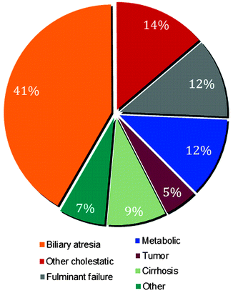
Classical indication for liver transplantation
ESPGHAN 2023-Xavier Stephenne

Slide 12
Chronic end-stage liver disease:
Biliary cirrhosis due to extrahepatic biliary atresia
Alagille’s syndrome
Progressive familial intrahepatic cholestasis (PFIC) syndromes
Sclerosing cholangitis
Some cases of congenital hepatic fibrosis with Caroli’s disease
Cystic Fibrosis liver disease (the latter may be in conjunction with lung transplantation)
Chronic hepatocellular disease due to neonatal hepatitis, chronic hepatitis B, C
Autoimmune chronic active hepatitis
Alpha-1-antitrypsin deficiency
Metabolic diseases such as tyrosinaemia, Wilson’s disease,
« Cryptogenic cirrhosis »
Vascular abnormalities such as Budd-Chiari syndrome

Slide 13
Criteria for referral
Chronic end-stage liver disease
There are multiple parameters used to predict the need for liver transplantation,
Some scoring systems are available.
The presence of synthetic failure, one or more complications, and features of progressive morbidity all indicate the need for OLT, considering also the potential waiting time for a suitable donor.
Note: Prior to availability of OLT, in biliary atresia and failed porto-enterostomy (i.e., persisting jaundice), the median age of death was 14 months.

Slide 14
PELD
The Pediatric End-stage Liver Disease, or PELD Score, is used to estimate relative disease severity and likely survival of patients awaiting liver transplantation.
Underestimation of the severity for young children
Balance between severity and access to liver transplantation

Slide 15
Criteria for referral
Chronic end-stage liver disease
Liver synthetic failure
Complications include:

Slide 16
Criteria for referral
Chronic end-stage liver disease
Parameters of synthetic failure include:
PTT > 20 secs
Albumin < 3.0
Indirect bilirubin > 100mg/dL (1 mg/dl = 17.1 µmol/l)
Na < 132
Cholesterol < 100mg/dL

Slide 17
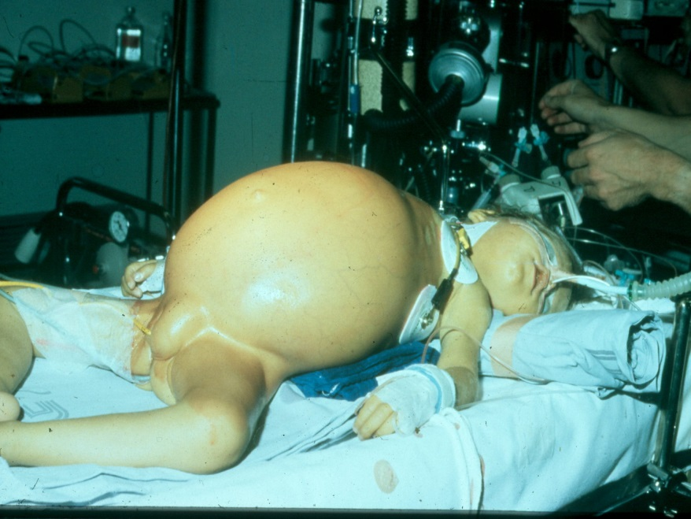
Criteria for referral
Chronic end-stage liver disease
Recurrent variceal bleeding
Refractory ascites
Recurrent spontaneous bacterial peritonitis/cholangitis
Growth failure
Intractable pruritus
Rickets/Pathological fractures
Complications include:

Slide 18
Criteria for referral
Chronic end-stage liver disease
Oxygen desaturation/Intrapulmonary shunts (Hepato-pulmonary syndrome, porto-pulmonary hypertension)
Hepato-renal syndrome
Enkephalopathy
Hepatocarcinoma (How to detect?)
Poor quality of life
Complications include:

Slide 19
Acute fulminant liver failure:
Disease type
Fulminant viral hepatitis (hepatitis A, B, C, adenovirus, CMV, measles, herpes, varicella, echovirus, blablabla,…)
Drug toxicity (acetaminophen, sodium valproate, halothane etc)
Toxin induced (amanita phylloides mushrooms)
Metabolic diseases (Wilson’s disease, galactosaemia, tyrosinaemia, fatty acid oxidation defects such as LCAD, LCHAD, neonatal haemochromatosis)
Acute vascular diseases (veno-occlusive disease and Budd-Chiari syndrome)
Genetic disease (RINT1, NBAS,…)

Slide 20
Acute Fulminant Liver Failure
Each case is assessed on an individual basis.
However, without transplantation < 50% will recover.
Thus patients should be referred to a transplant center, supported aggressively, and listed for transplant.
Children with AFLF have the highest priority for regional sharing of donor organs.
The option of live-related organ donation can be explored.
When a donor becomes available, the decision for OLT can be made, but if while waiting, there are signs of stabilization (lack of progressive deterioration) or evidence of recovering function (improved coagulation parameters), transplantation may be avoided.
  How to avoid to transplant a recovering patient?

Slide 21
Acute Fulminant Liver Failure
Urgent transplantation is considered
-if INR is greater or equal to 3.5 or plus three of the following:
age <11 years
period of encephalopathy with jaundice interval > 7 days
serum bilirubin > 300umol/L (17.5 mg/dl)
(liver biopsy shows < 50% viable hepatocytes and no regeneration)
-if INR > 6.5

Slide 22
Acute Fulminant Liver Failure
For acetaminiphen intoxication,
consider transplant if
pH < 7.3
Or
Creatinine > 0.3mmol/L
INR > 6.5
Grade 3 or 4 hepatic encephalopathy

Slide 23
Other
Hepatic metabolic/genetic diseases with debilitating extrahepatic manifestations: glycogen storage disease type IV, III, Crigler-Najjar syndrome, urea cycle defects, protein C deficiency, familial hypercholesterolaemia, primary hyperoxaluria.
Malignant liver neoplasms: hepatoblastoma, hepatocellular carcinoma, haemangioendothelioma

Slide 24
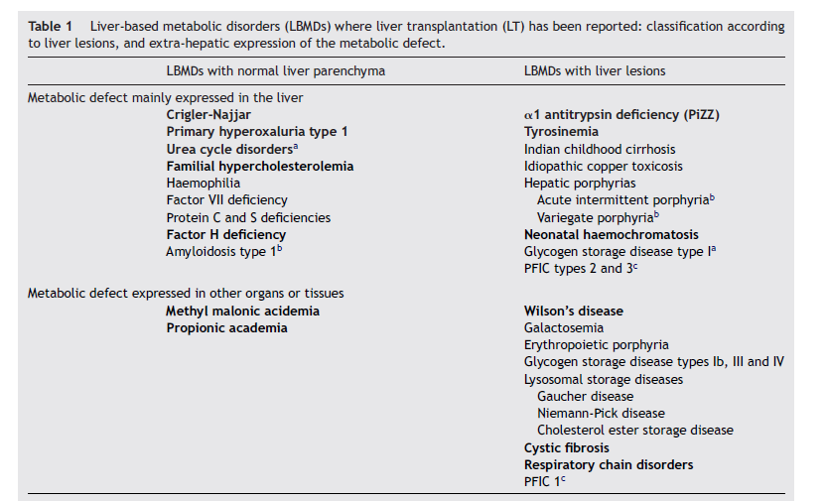
Metabolic diseases

Slide 25
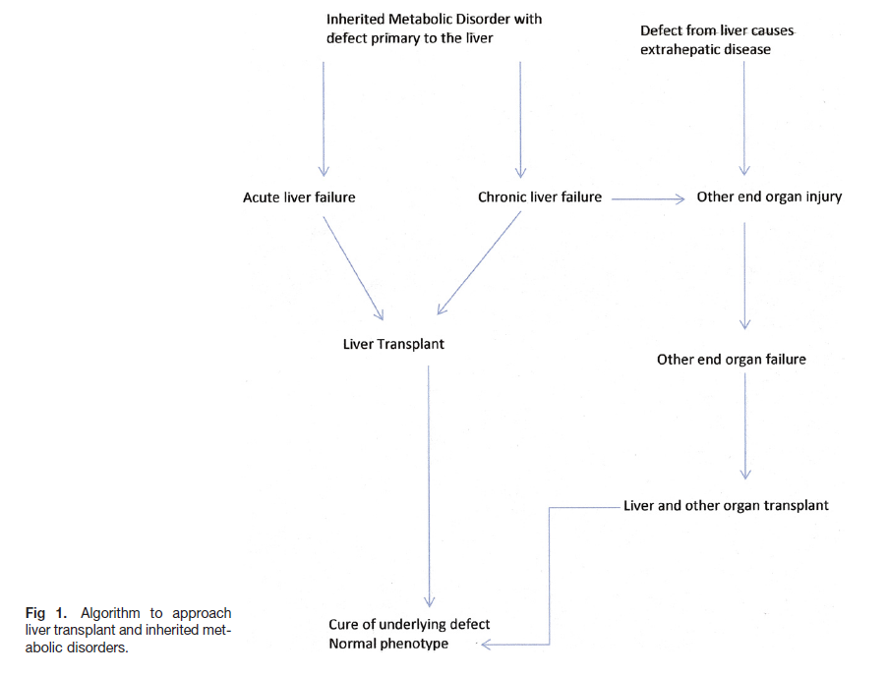
Metabolic diseases
Enzyme defect
Hyperoxaluria
Methylmalonic aciduria
Glycogenosis type 1

Slide 26
Contra-indications
Absolute:
Primary extrahepatic unresectable/untreatable malignancy, malignancy metastatic to the liver
Progressive terminal non-hepatic disease
Uncontrolled systemic sepsis
Irreversible neurologic injury (Nieman Pick Type C), mitochondrial disorders with progressive neurological involvement.
Relative:
Severe pulmonary hypertension
Severe developmental or psychosocial problems obviating compliance and follow-up.

Slide 27
Conclusion
Team work/You must never walk alone
Experts
Humbleness Ethics Patient and family
Organ allocation (post-mortem, living donor)
ESPGHAN 2023-Xavier Stephenne

Slide 28
Indication de greffe hépatique
Maladie cirrhogène
Cirrhose décompensée
  Ictère
  Ascite
  Hémorragie digestive (coagulopathie, HTPortale)
  Insuffisance hépatique
  Encéphalopathie
  Syndrome hépato-pulmonaire
  Hypertension porto-pulmonaire
  Syndrome hépato-rénal
Cholangites à répétition
Hépatocarcinome

Slide 29
Indication de greffe hépatique
Tumeur hépatique
  Hépatoblastome prétexte 4
  Autre tumeur du foie
Mauvaise qualité de vie
  AEG, fatigue,…
  Prurit (cholestase familiale, syndrome d’Alagille)
    Echec du traitement médicamenteux
    Echec interruption cycle entéro-hépatique
      Médicament
      Drain nasobiliaire
      Chirurgie de dérivation biliaire (interne, externe)

Slide 30
Contre-Indication à la greffe
Décision difficile
Peu de contre-indications
  Métastases extra-hépatiques non curables
  Hypertension artérielle pulmonaire sévère (risque per-opératoire)
  Maladie neurologique
  Séquelles
  Maladie évolutive
  Maladie affectant d’autres organes
  Métastases extra-hépatiques non curables

